Slide 1
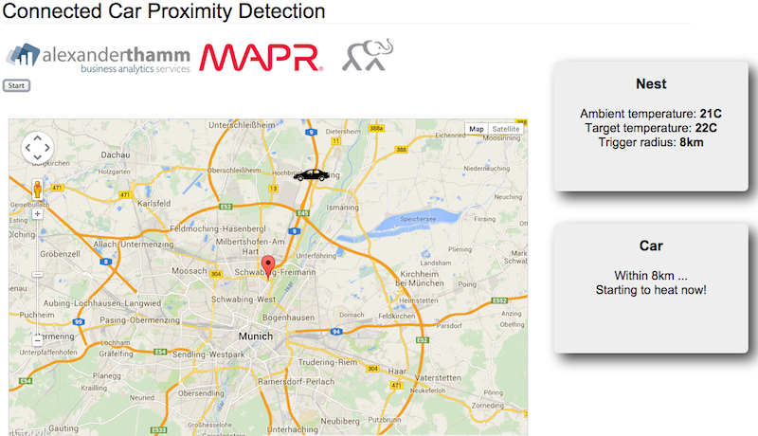
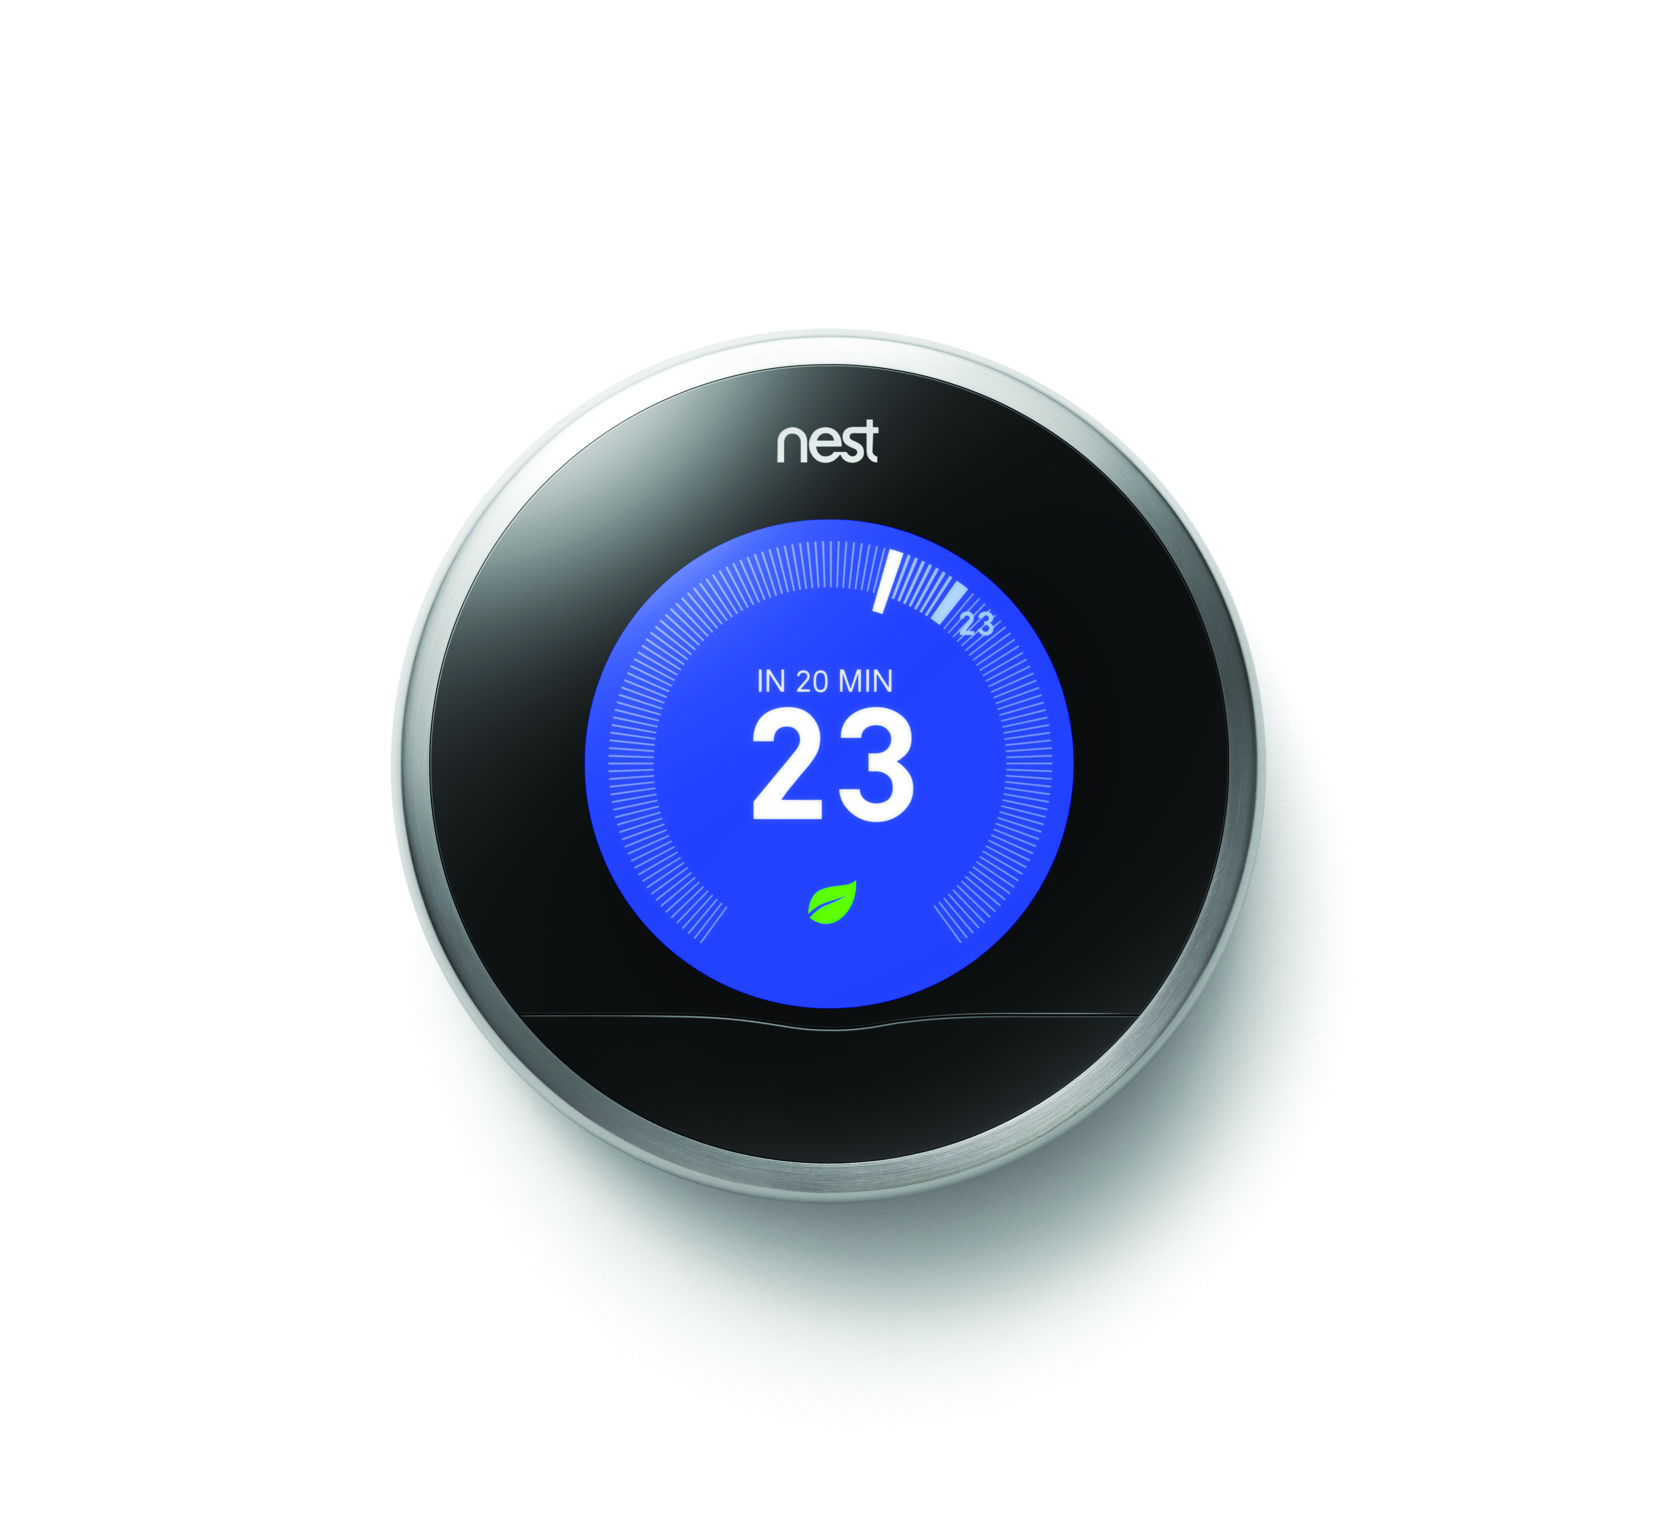








Connected Car: Proximity Detection on MapR Data Platform
Car
Data Processing
Home
Temperature Control
OBD2
trigger logic
Data Acquisition
Raspberry PI
fluentd
fluentd

